Slide 1
NYC Subway Social Distancing Risk Analysis
CSCI 740 – Modeling and Simulation Hunter College Fall 2020
Alex Washburn, Andrew Lee, Kamil Sachryn, Chuanyao Lin, Ye Paing
Notes:
ID=d924773e-9a16-4d6d-9803-8cb819e99682
Recipe=text_billboard
Type=TextOnly
Variant=0
FamilyID=AccentBoxWalbaum_Zero
1

Slide 2


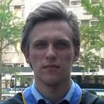



Team 1
Alex Washburn
Andrew Lee
Kamil Sachryn
Chuanyao Lin
Ye Paing
CSCI 740 Modeling and Simulation – Fall 2020
2

Slide 3

Agenda
Motivation
Model
Methods
Preliminary Results
Discussion & Further Work
11/28/2020
CSCI 740 Modeling and Simulation – Fall 2020
3
Notes:
3

Slide 4
Motivation
Motivation for our project, context and research questions.

Slide 5
Is the MTA Subway system safe to ride in this time of COVID-19?
What are the relevant facts?
CSCI 740 Modeling and Simulation – Fall 2020
5

Slide 6
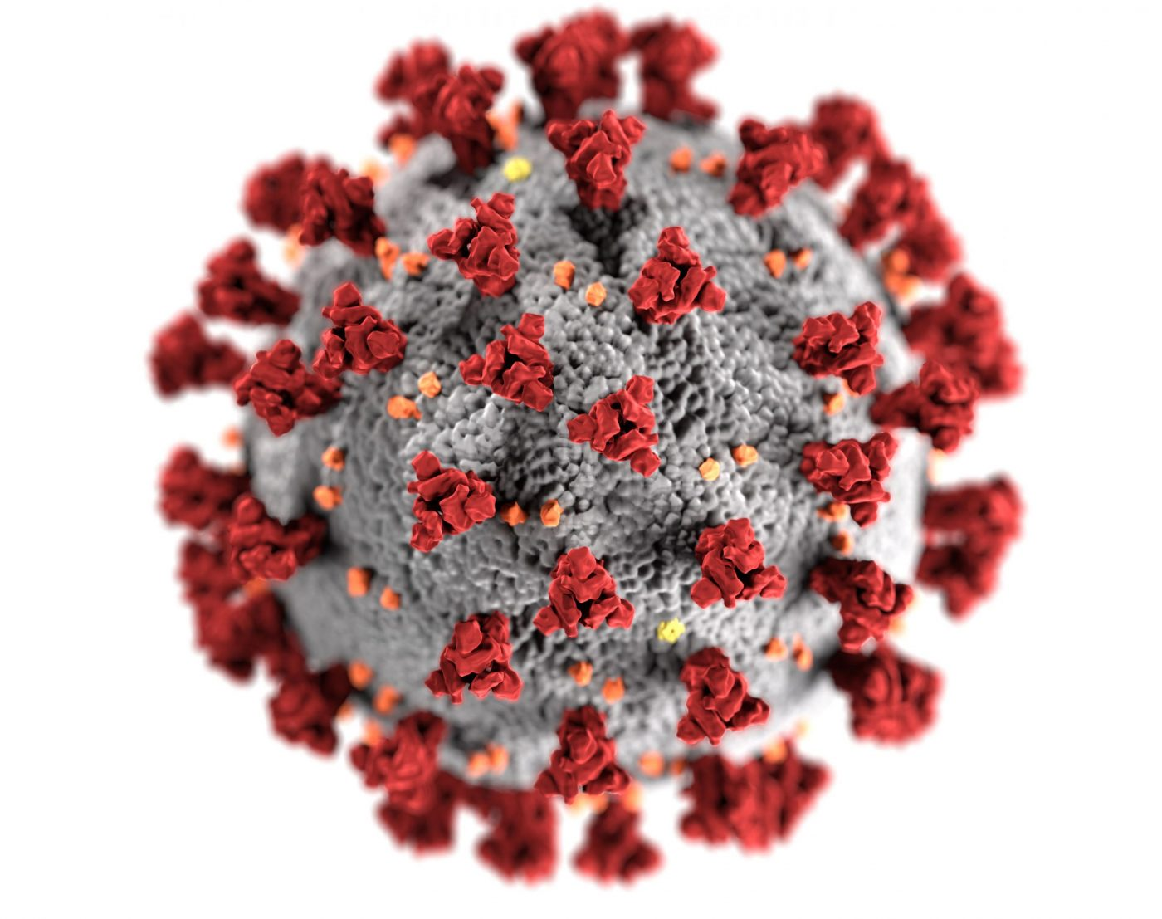
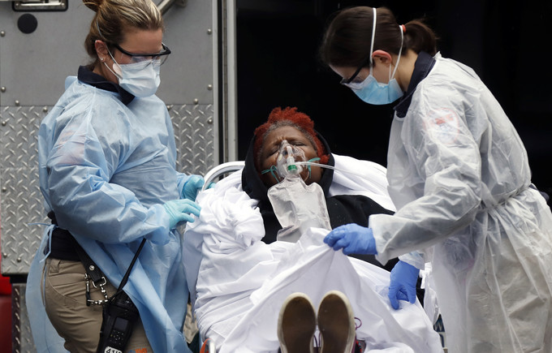
Epidemiology
The Virus: SARS COVID-II
The Disease: COVID-19

Slide 7
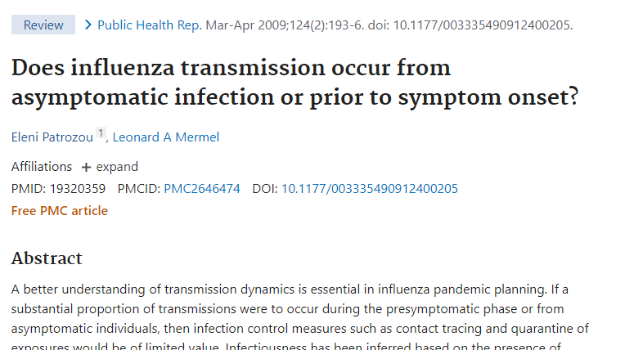
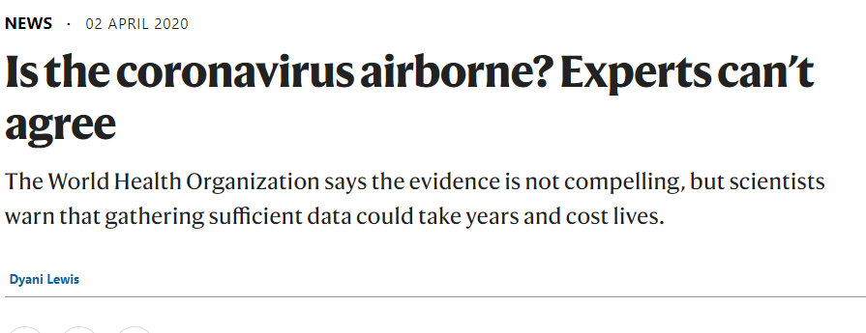
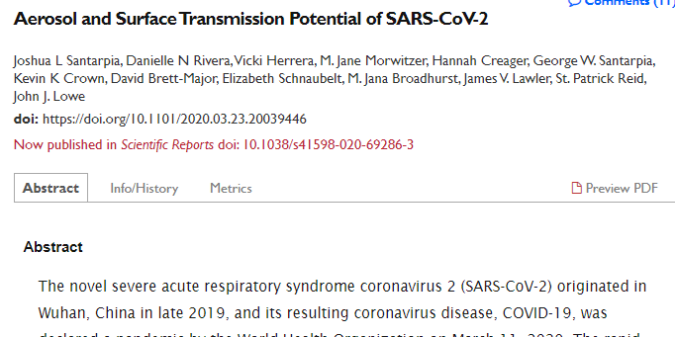
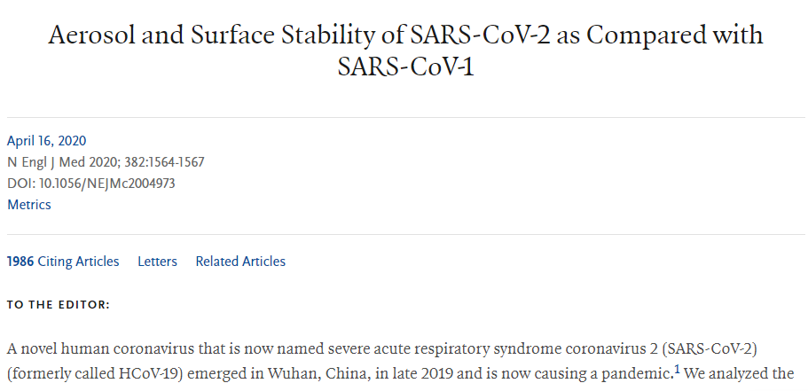
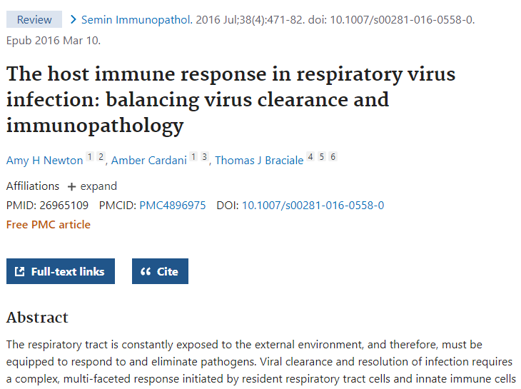
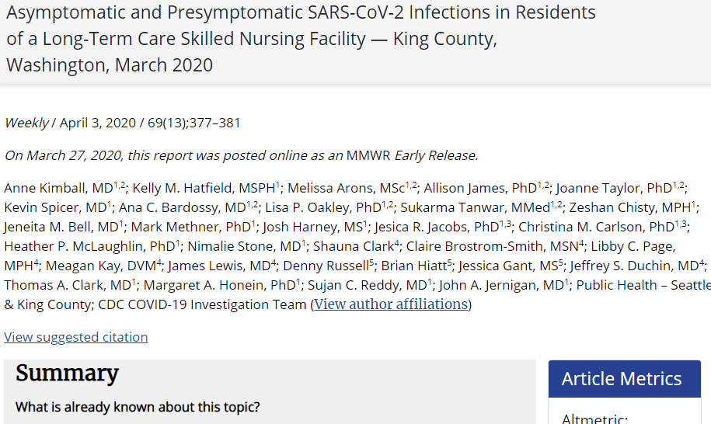
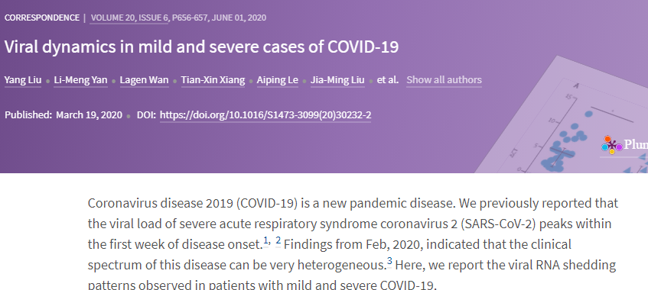
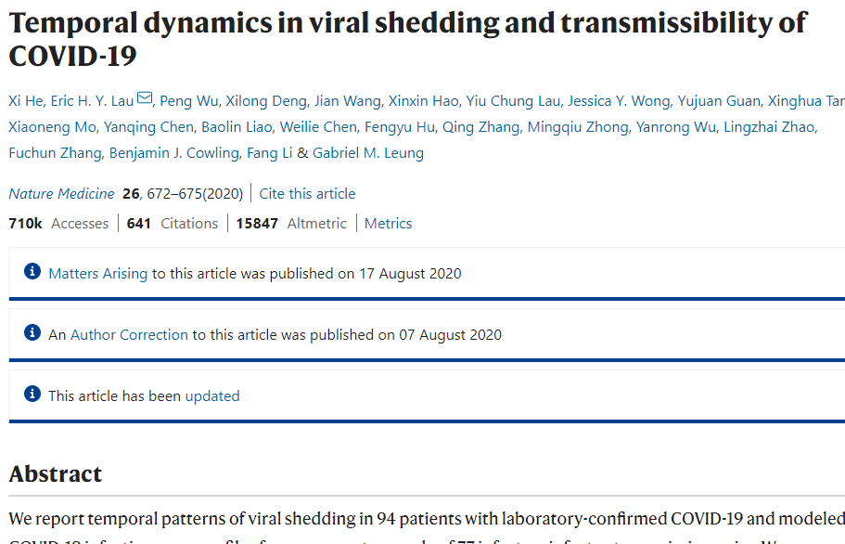
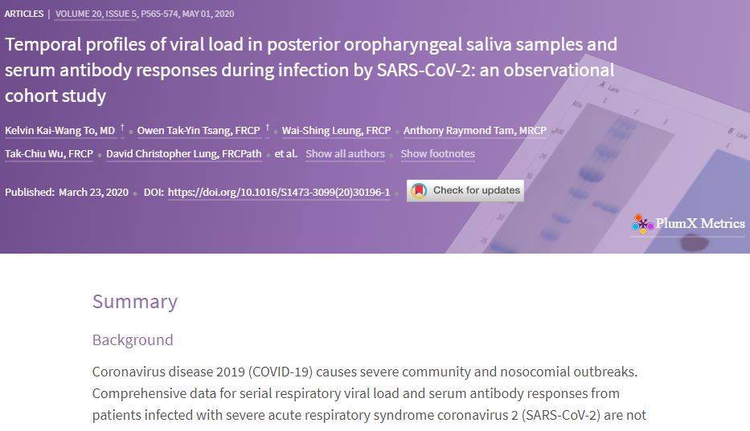
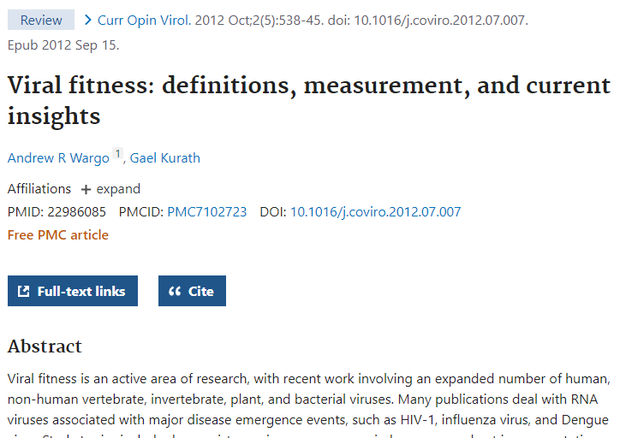
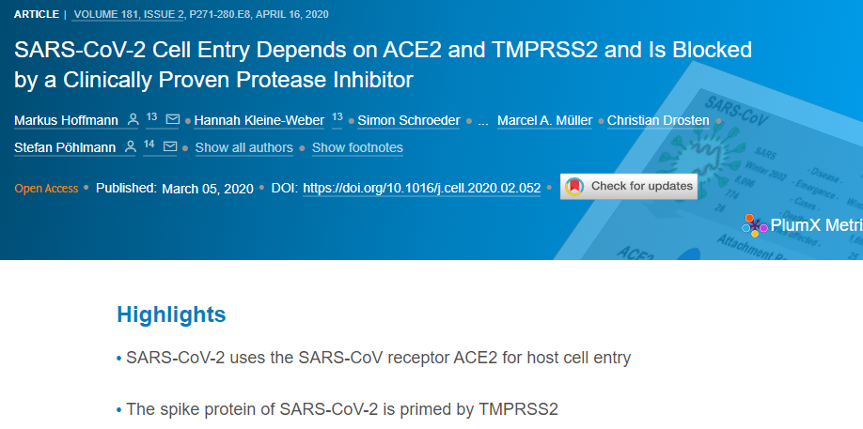


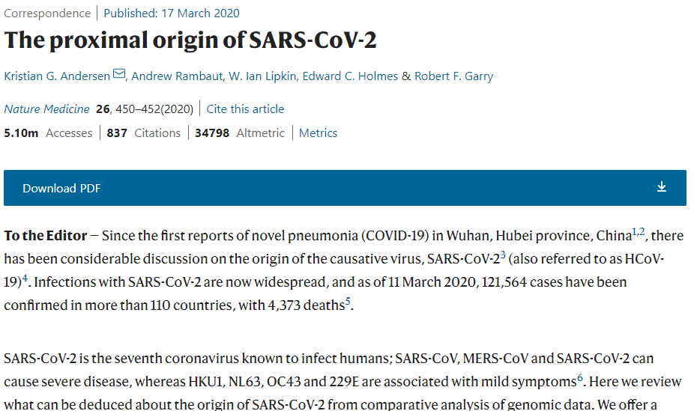

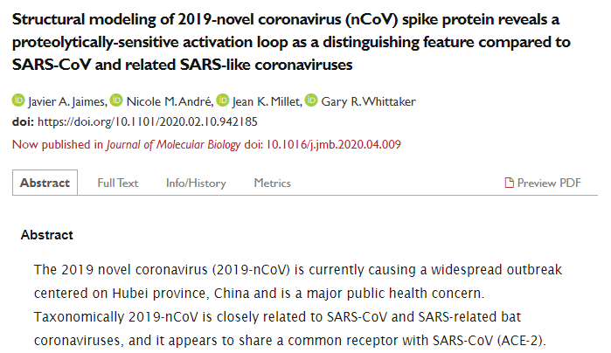
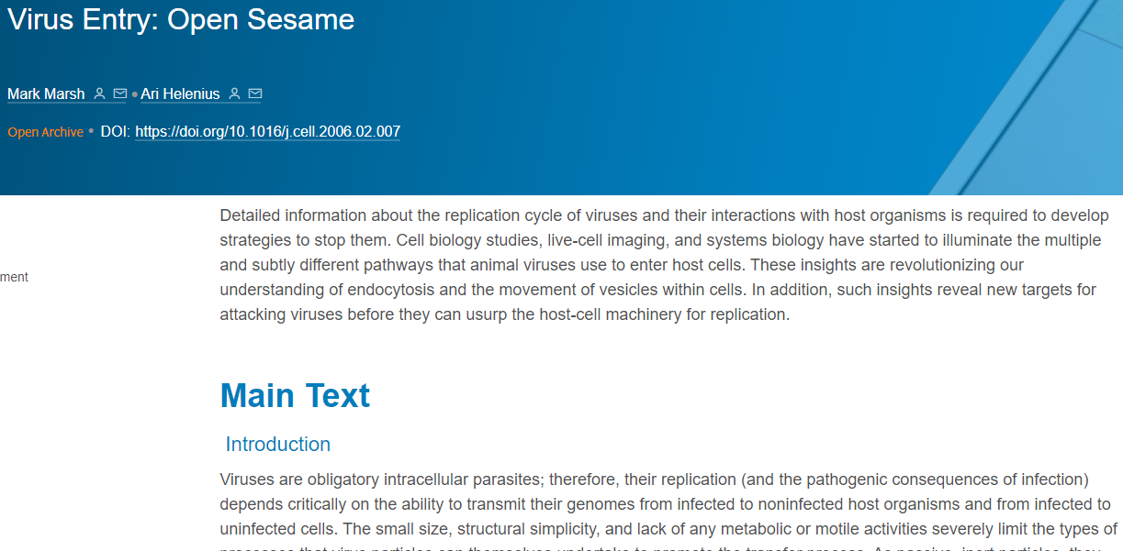

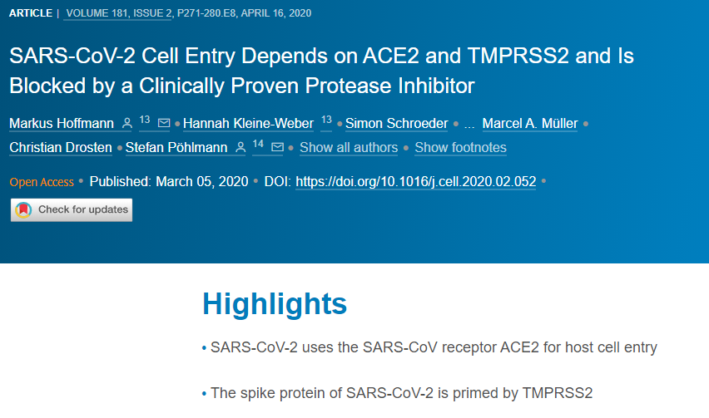

Let’s Gain Some Insight from Research

Slide 8

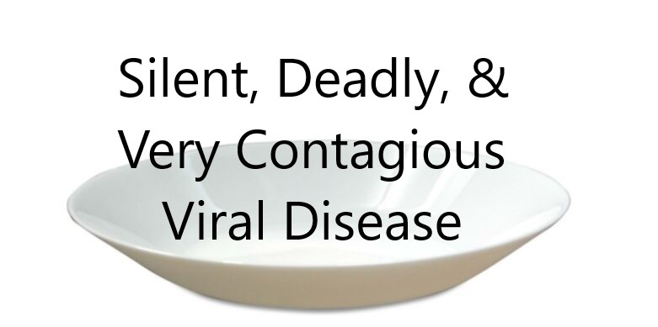
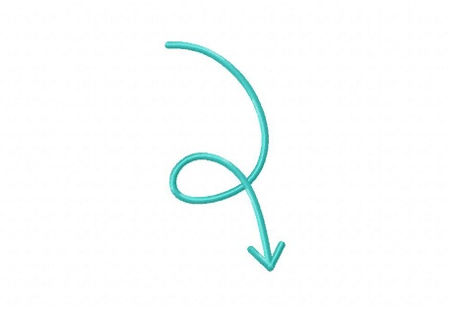

Why is SARS COVID-II So Contagious?
Presymptomatic Transmission (not common)
Asymptomatic Transmission (not common)
Viable Transmission in Smaller Saliva Droplets
Really High Viral Load – Enough for Infectious Dose
Virus infection ≠ Symptoms. Immune Response = Symptoms
Peak Viral Load occurs Before or Onset of Symptoms (not common)
10X Adhesion of Spikes to Cell Membrane vs Old SARS virus
More Effective Virus – Lower Infectious Dose
Can Live on Plastic/Steel Surfaces up to 72 hours
Infected Non-infected
Contagious Non-Contagious
Notes:
Presymptomatic Transmission (not common incl. SARS) – people can pass along virus before they start showing symptoms
Asymptiomatic Transimission (not common incl. SARS) – some people pass along virus without actually getting sick themselves
Viable Transmission in Smaller Saliva Droplets
Really High Viral Load – Enough for Infectious Dose
Virus infection ≠ Symptoms. Immune Response = Symptoms
Peak Viral Load occurs Before or Onset of Symptoms (SARS 10 days after)
Easy portability, higher concentration, lower viral load threshold
8

Slide 9
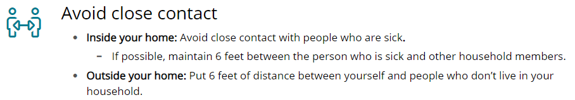
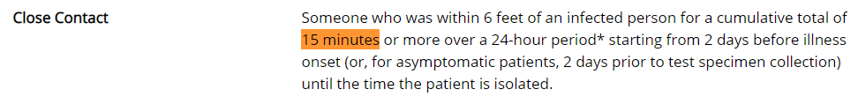
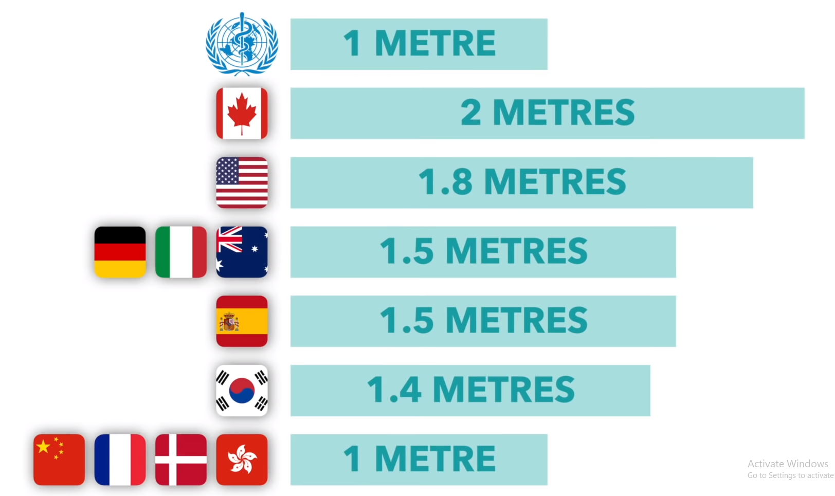

U.S. CDC Recommendations
Is this true? Is this good enough?
Source: https://www.thelancet.com/journals/lancet/article/PIIS0140-6736(20)31142-9/fulltext

Slide 10
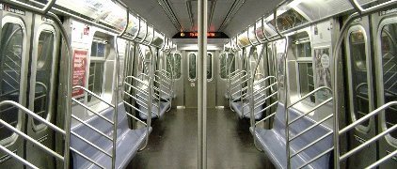
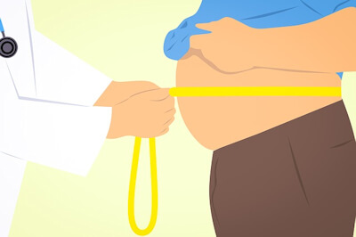

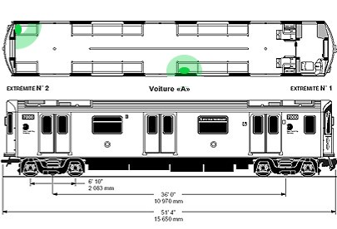
1. Average Waistline
How many people can safely fit on the subway?
2. 3ft Distancing Radius
3. Corner and Edge Cases
Sources:
Body Measurement of U.S. citizens from 1999 to 2016 research paper: https://www.cdc.gov/nchs/data/nhsr/nhsr122-508.pdf
Population of Males and Females in NYC: https://www.baruch.cuny.edu/nycdata/population-geography/pop-demography.htm

Slide 11


How many people can safely fit on the subway?
RESULTS:
Radius of each human body is ~ 0.16m.
Radius of one “bubble” from the center of human body is ~ 1.075m.
Area of the train car is 54.65m^2 (18.35m x 2.98m)
Area of a full-sized bubble is 3.44m^2 (Corner bubble is ¼ and Edge bubble is ½.)
Safe Capacity (# of people a train car hold while having everyone safely social distanced) = 25! (approx.)

Slide 12
“How do different arrival rates of the trains/passengers impact the transmission risks of passengers for the duration of their trip?”
COVID-19 ‘s impact and disruption on our daily lives here in NYC, specifically on our transportation system.
Study the effectiveness of our social distancing guidelines
Simulate our current train schedules to determine the transmission risks and outcome based on current COVID-19 data.

Slide 13
Model
Background of the models we’re using.

Slide 14
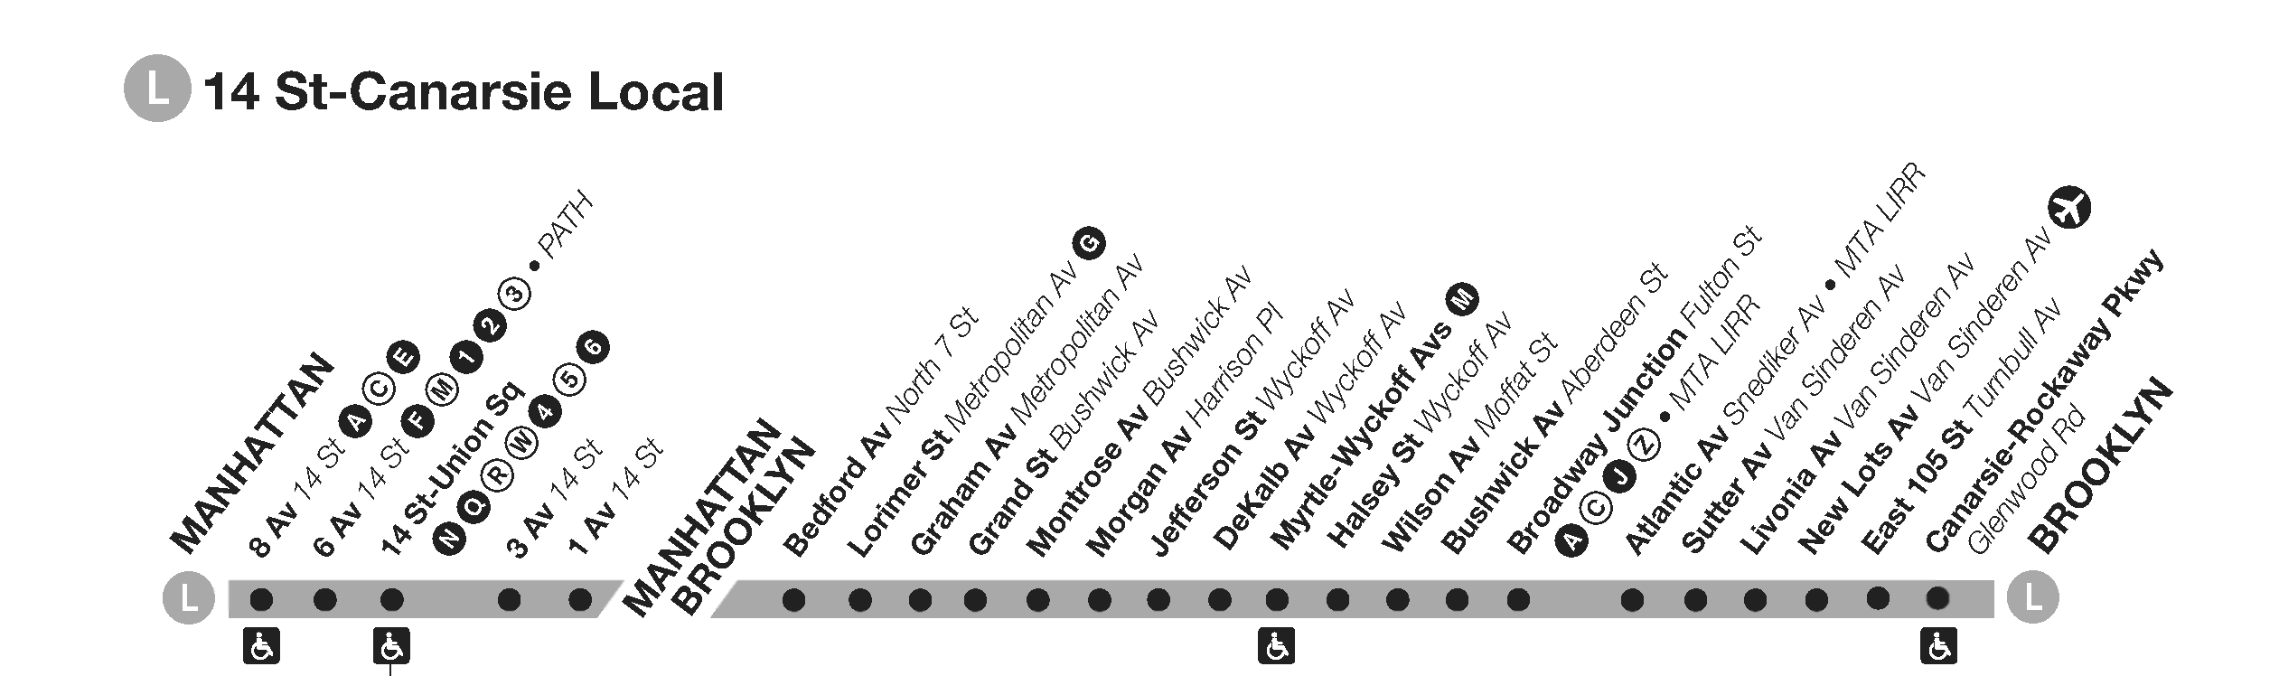
The Subway Line
Subway line dynamics
Each station is a Poisson process of arrivals
The arrival rate for station S_{i} is λ_{i}
Each station has a queue of passenger which have arrived
Each arriving passenger P_{j} has a destination S_{j}
Each station has different destination distributions for passenger
CSCI 740 Modeling and Simulation – Fall 2020
14

Slide 15
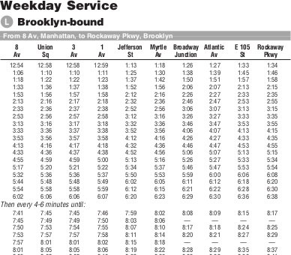
Train Schedule
Train schedule semantics
Each train starts at one end of the line
Each train ends at the opposite end of the line
Simulation is one-way direction of the subway line
Trains move deterministically through the stations
At each station, passengers disembark if at S_{i}
At each station, passengers embark from the queue
Multiple trains run through the tracks
Trains have multiple cars, cars have a max capacity
CSCI 740 Modeling and Simulation – Fall 2020
15

Slide 16
The Passengers
Passenger attributes
A passenger arrives at a station S_{i}
A passengers has a destination S_{j}
Passengers have probability c of starting with the virus
Passengers queue at S_{i} until a train arrives at S_{i}
Passengers disembark from the train first
Queued passengers embark onto the train
While in transit, we track passenger social distancing
Not social distancing risks transmission of the virus
CSCI 740 Modeling and Simulation – Fall 2020
16

Slide 17
Virus Transmission Risk
Modeling transmission
While two passengers are not social distancing
If one passenger has the virus and the other does not
Each minute there is a probability p that both passengers will have the virus
CSCI 740 Modeling and Simulation – Fall 2020
17

Slide 18
Model parameters
Modeling transmission
An ordered collection of subway stations with infinite queues { S₀∞, S₁∞, ... S_{n}∞ }
An associated collection of arrival rates { λ₀, λ₁, ....λ_{n} }
An associated collection of departure station weights { μ₀, μ₁, … μ_{n} }
A train schedule { t₀, t₁, … t_{m} }
Virus transmission probability p (per minute)
Passenger starting with the virus probability c
CSCI 740 Modeling and Simulation – Fall 2020
18

Slide 19
Random Variable
Ratio of novel transmissions to initially healthy passengers
Track all transmissions of the virus within the subway trains (not stations)
Track total passengers who rode the subway
Provides an estimate that
if a passenger rides the subway
the virus will be transmitted to them
CSCI 740 Modeling and Simulation – Fall 2020
19

Slide 20
Controls and Interventions
Control
Interventions
Do not modify parameters
Modify train schedule to be more frequent
{ t₀, t₁, … t_{m} } ⟶ { t₀’, t₁’, … t_{m}’ }
Set maximum station queue to q
{ S₀∞, S₁∞, ... S_{n}∞ } ⟶ { S₀^{q}, S₁^{q}, ... S_{n}^{q} }
How do interventions change the expectation of the random variable?
CSCI 740 Modeling and Simulation – Fall 2020
CSCI 740 Modeling and Simulation – Fall 2020
20
20

Slide 21
Hypothesis
Increasing train arrival rates and/or
throttling passenger arrivals at
subway stations will decrease the
expectation of a passenger having
the virus transmitted to them
during their subway ride.
CSCI 740 Modeling and Simulation – Fall 2020
21

Slide 22
Method
Overview of the methods we are using to implement our model.

Slide 23
General Model Form
Naive Implementation
Retrospective Model
Tick-based simulation
(minute by minute)
Trains move deterministically
Run the simulation one train at a time
Calculate passenger arrivals between trains
CSCI 740 Modeling and Simulation – Fall 2020
23

Slide 24
Measuring social distance within the subway car
Objective
Solution
Detect all passengers with 1.7 meters (~6 feet) of a virus carrying passenger
Model the car as a hexagonal grid
Passengers each occupy one hex cell
Passengers with too few separating cells are not social distancing
CSCI 740 Modeling and Simulation – Fall 2020
24

Slide 25
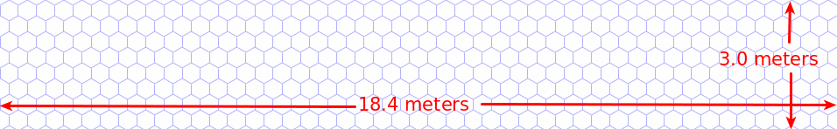
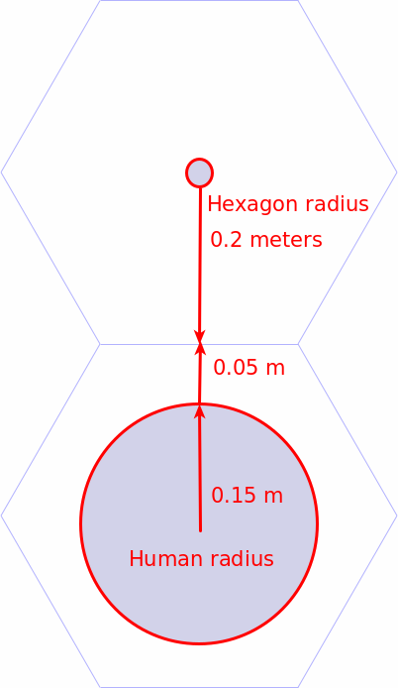
The hexagonal subway car
Human cross-section is roughly 0.15 meter radius
L line subway car (R143) dimensions 18.35 x 2.98 meters
Set each hexagon to have a 0.2 meter radius
Implement the train car as a 46 x 8 hexagonal grid

Slide 26
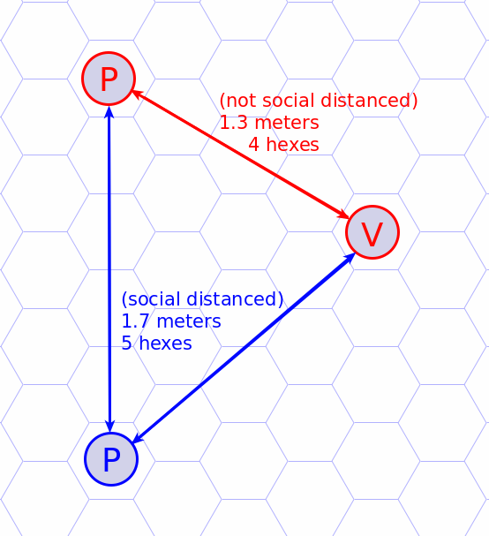
Calculating social distance
Just count the hexes between passengers

Slide 27
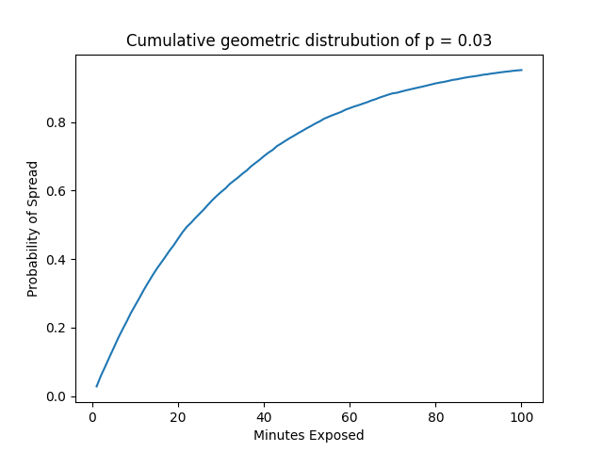
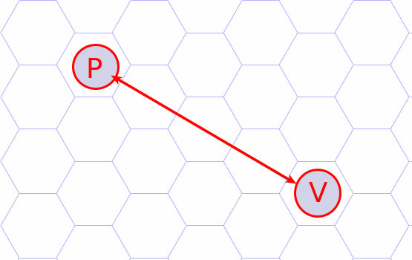
Each minute of exposure is a risk of the virus spreading
Each minute,
there is a probability p that passenger P gets the virus from passenger V.
We choose p = 0.03
We model this risk of spread by sampling a geometric distribution.
CSCI 740 Modeling and Simulation – Fall 2020
27

Slide 28
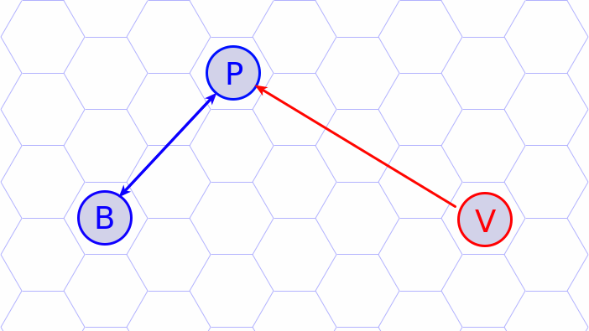
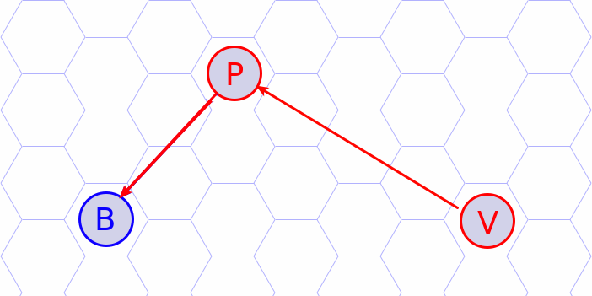
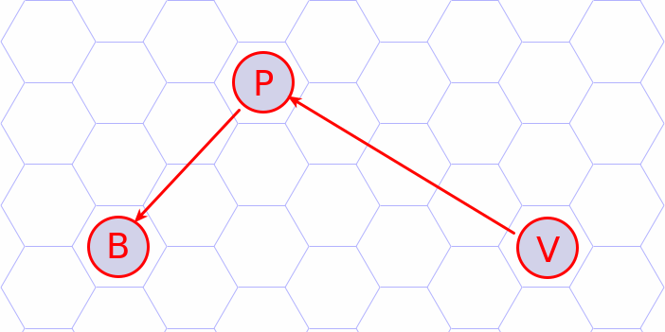
Virus spread can be transitive
T₀
T_{i}
T_{j}
As time advances with T₀ < T_{i} < T_{j} the virus transmits throughout the car
Two novel transmissions occur at T_{i} and T_{j}
CSCI 740 Modeling and Simulation – Fall 2020
28

Slide 29
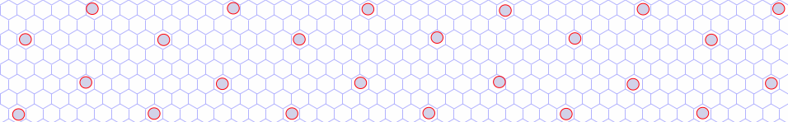
Train Embarking
The train car can hold 24 passengers safely
The first 24 passengers board deterministically to these “safe” spots
Passengers after the 24th select an empty cell uniformly at random

Slide 30
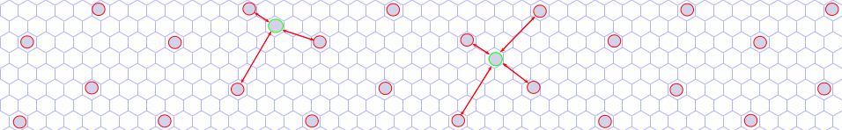
Train Embarking
After the 25th passenger boards, there will be at least 3 passengers who cannot social distance
If any of these passengers have the virus, there is a risk of transmission

Slide 31
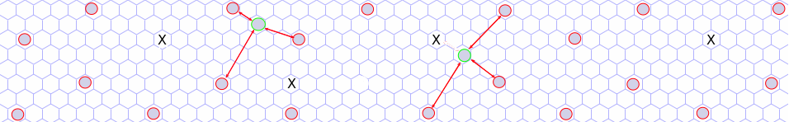
Train Disembarking
When the train reaches S_{i}, each passenger whose destination S_{j} equals S_{i} disembarks

Slide 32
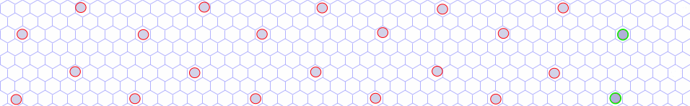
Train Disembarking
If the car has less than 25 passengers, they rearrange themselves to a safe distance

Slide 33
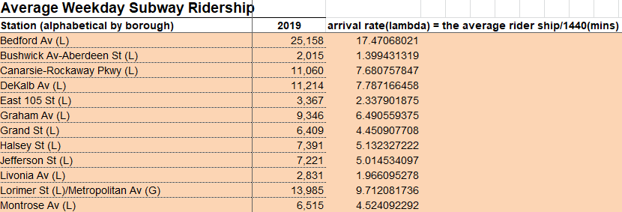
Passenger arrival rate(λ)
Objective
Solution
Estimating the passenger arrival rates of each station
Using the data“2019 Subway Ridership Tables” from the MTA to get the average weekday subway ridership
λ = The Average Ridership / 1400(mins)
CSCI 740 Modeling and Simulation – Fall 2020
33

Slide 34
Preliminary Results
Plots of our preliminary results.

Slide 35
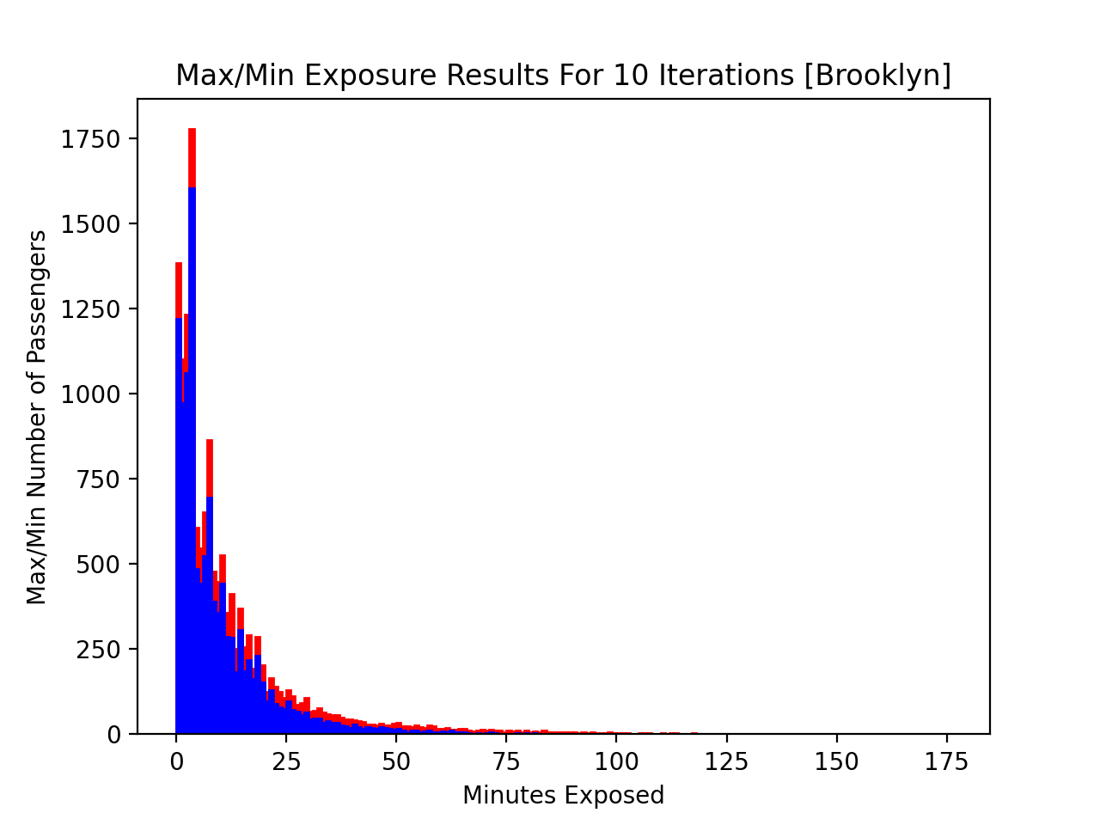
Passenger exposure rate preliminary results for 10 iterations of our simulation
9/4/20XX
Presentation Title
35
Notes:
35

Slide 36
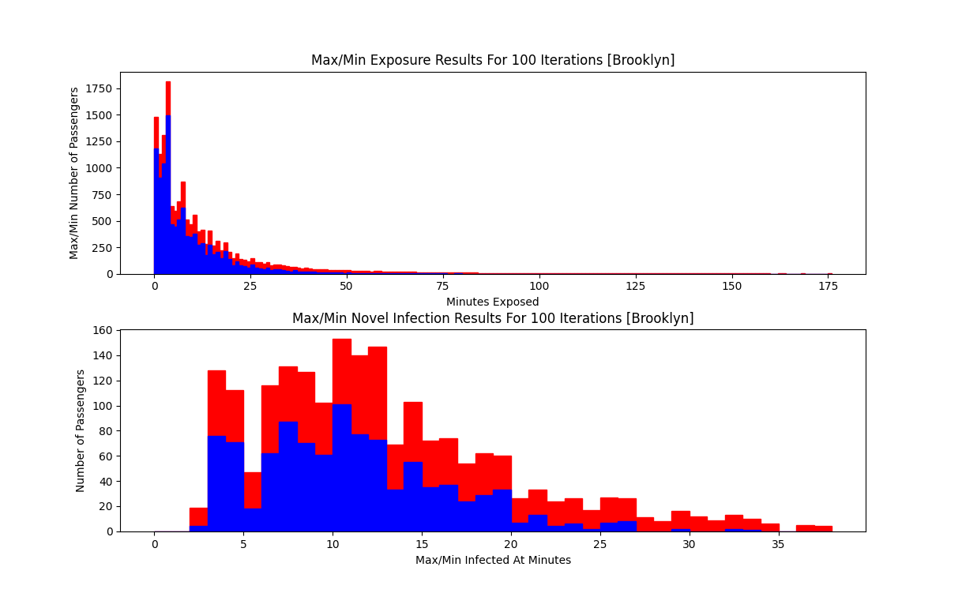
9/4/20XX
Presentation Title
36
Notes:
36

Slide 37
Discussion
Discussion for further work and enhancements.

Slide 38
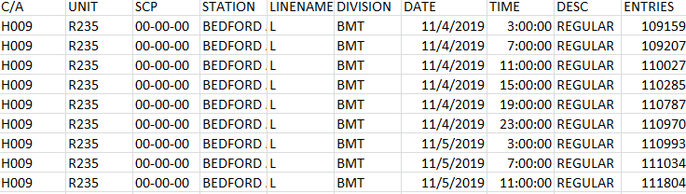
Updating Passenger arrival rate(λ)
Initial arrival rates(λ)
Improvement
Based on the data of the average ridership of one day, we generate the passengers with fixed rate in our model.
However, in the real world, more passenger will arrive during the peak hour.
We found another data of each turnstile in each station with different time from the MTA. So, we could generate passengers more precisely with the different time interval.
CSCI 740 Modeling and Simulation – Fall 2020
38

Slide 39
Future Work
Variance Reduction Techniques
Performance
Control Variate
Choosing the ratio of number of overly packed trains to number of total train cars [in one replication] as our correlated RV.
Antithetic Variables.
Generating our complement simulation result by alternating the spawning of infected passengers with a U(0,1) and 1 – U(0,1)
Implement CPU performance tracking.
Increase simulation run time performance by removing debugging logs, minimizing the number of I/O operations to allow simulation to run faster.
CSCI 740 Modeling and Simulation – Fall 2020
39

Slide 40
Thank You

